Slide 1
Cluster randomised
crossover registry-based
trials
Andrew Forbes
Monash University
ACTA Registry Randomised Trials, May 19 2020
ACTA gratefully acknowledges operational funding from the Australian Government’s Medical Research Future Fund

Slide 2
Outline
Registry randomised trials
Individual vs cluster randomised trial designs
Clustering with crossing over – the benefits
The PEPTIC cluster crossover registry-embedded trial
General comments about cluster crossover RRTs

Slide 3
Registry randomised trials
Randomised trials conducted within a registry
Randomisation ensures high internal validity
Registry ensures external validity – real-world patients
Ideally unselected patients, fast recruitment
Consent options – waiver, opt-out? → Case by case
Ideally all followup outcomes routinely collected

Slide 4
Registry randomised trials
The downside: You get what you get
Endpoints may not be exactly what would choose in a non-registry RCT
Data quality is only as good as the registry
May not have available ‘auxiliary’ variables (e.g. compliance, biomarkers, subgroup variables)

Slide 5
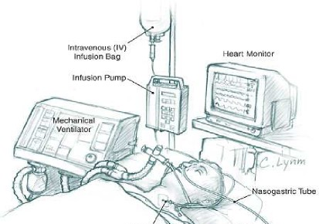
Registry trial examples: Intensive care
near-universal interventions
Australia and New Zealand Adult Patient Database (APD) – registry updated quarterly
e.g. admission characteristics, ICU/Hosp LoS, Hosp mortality, key clinical monitoring chars.
FLUIDS: Balanced electrolytes or normal saline solution?
OXYGEN:
Oxygen saturation:
90%, 95%, 98% ??
NUTRITION: How many calories/day?
STRESS ULCERS:
Interventions to prevent?

Slide 6
RCT example question:
Stress ulcer prophylaxis in ventilated patients
Vast majority of mechanically ventilated patients in ICUs receive stress ulcer prophylaxis (SUP)
  Most common: Proton Pump Inhibitors (PPIs)
  and Histamine₂ Receptor Blockers (H2RB)
  Variation more to do with physician and hospital preferences/opinions than it does with patient characteristics
Protective effect of PPI on upper GI bleeding clear
Effect on mortality unknown
  But will not be huge effect
→ Needs large comparative effectiveness trial

Slide 7
Individually randomized trial?
Randomise individual mech vented patients to PPI or H2RB
In-hospital mortality ~15%
  Want to detect 15% reduction, 80% power (15% → 12.7%)
  Trial over 6 months (~310 pats/site, from APD registry )
  Need 7400 patients [24 sites]
But prohibitive in terms of logistics and cost, individual consent
→ Need an alternative study design
  Randomisation of whole ICU units, outcomes collected via registry, and simplified consent since interventions routine
  → “Registry-embedded cluster randomised trial”

Slide 8
Cluster randomised trials –schematics
Randomise clusters (ICU, practice, school) rather than individuals
TIME →
Parallel cluster RCT
Cluster crossover
Stepped Wedge
(no switch back)
Interv’n (A)
Control (B)

Slide 9
Parallel cluster randomised trial
MUST consider “clustering effects”
Mortality varies across ICUs
Patients within same ICU more similar in mortality risk than patients of two different ICUs : within-ICU correlation
→ Not independent information per patient
→ Loss of information, smaller effective sample size

Slide 10
Parallel cluster RCT sample size
Use ANZ APD registry data to determine key design parameters
  [Registries good for design too!]
Within-ICU mortality correlation ICC ~ 0.035 [APD 2013-2014]
Avg 310 patients/ICU/6 months
But clustering effects are brutal:
  An ICU with 310 patients has equivalent information to only 26 independent patients !!
  Trial for 15% reduction would need 88,000 patients in 284 ICU’s!
Notes:
Registry data can be used to effectively DESIGN trials. Key “nuisance” parameters directly relevant

Slide 11
Cluster and Cross Over
Cluster crossover trials:
  Each ICU randomised to an intervention sequence
  over two 6 month periods
  PPI → H2RB or H2RB → PPI
  PPI vs H2RB effect estimated by comparisons made within each ICU then aggregated
  → Removes between-ICU variability
End result:
  Cluster crossover trials typically need much smaller number of ICUs and patients than standard parallel cluster trials
  Q: How much smaller?
PPI | H2RB
H2RB | PPI

Slide 12
Within cluster correlations
– and then there were two
Two forms of intracluster correlation
Between patients in same ICU within same period
“within period” → BAD [“clustering corr”]
Between patients in same ICU across different periods [trts]
“between period” → GOOD [“crossover corr”]
GOOD ≤ BAD
Their relative size determines value of crossover
PPI | H2RB
H2RB | PPI
Note: Between-period is “good” only because of the crossover design
Notes:
GOOD correlation: When comparing two treatments, want everything to be the same apart from treatment. So here want everything the same (high correlation) between period 1 and period 2 measurements because they are in different treatment conditions

Slide 13
Wind back the clustering effect ?
% reduction of clustering effect due to crossover
80%?
50%?
33%?
1:1 RCT
Cluster RCT
7400 pats
88000 pats
Amount wound back depends on size of $\frac{GOOD ICC}{BAD ICC}$ (approx.)

Slide 14
PEPTIC planning – trial over two 6-month periods
Within-period (BAD) ICC= 0.035
Between-period (GOOD) ICC= 0.025 [Good/Bad = 0.71]
To detect 15% reduction with 310 pats/ICU/6months, 80% power:
→ 50 ICUs = 31,000 patients
Indiv RCT: 7400 patients (24 ICUs)
Cluster RCT: 88,000 pats (284 ICUs)
Cluster Crossover: 31,000 pats (50 ICUs)
→ 66% of the clustering effect on #patients has been recovered
[and 82% of number of ICUs]
Notes:
Cluster RCT needs 23-fold higher sample size. Crossover needs 4.2 times sample size. SO savings is (23-4.2)/23 = 0.82

Slide 15
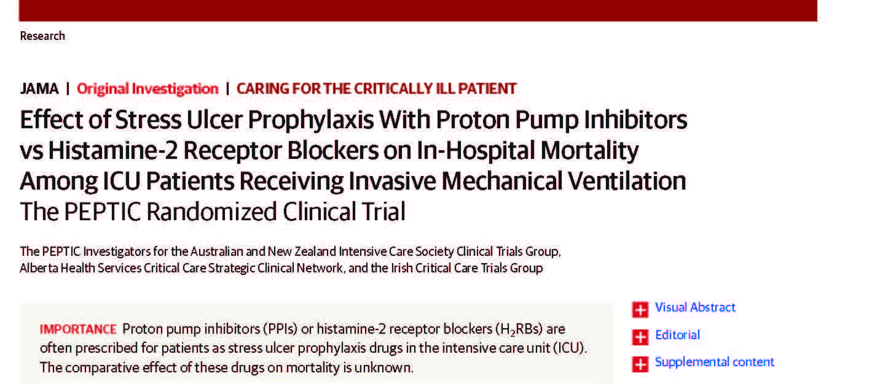

The PEPTIC cluster crossover registry-based trial
26 982 patients
50 ICUs [Trts open-label]
5 countries
Budget <USD$500k
JAMA. 2020;323(7):616-626.
A combination of registry
& trial-specific
data sources
Consent: Waiver or opt-out according to local HREC (154/26982 = 0.6% opted out)
Notes:
Aust, NZ, UK, Canada, Ireland

Slide 16
PEPTIC data sources
From registries in each country
Baseline characteristics, ventilation information (some)
Mortality, ICU/Hosp LoS
Site-specific resources (i.e. by local site coordinator):
Upper GI bleeds and C.diff infections
Monthly one-day audits or electronic or pharmacy records of actual stress ulcer prophylaxis used (adherence)
  Not comprehensive individual level use

Slide 17
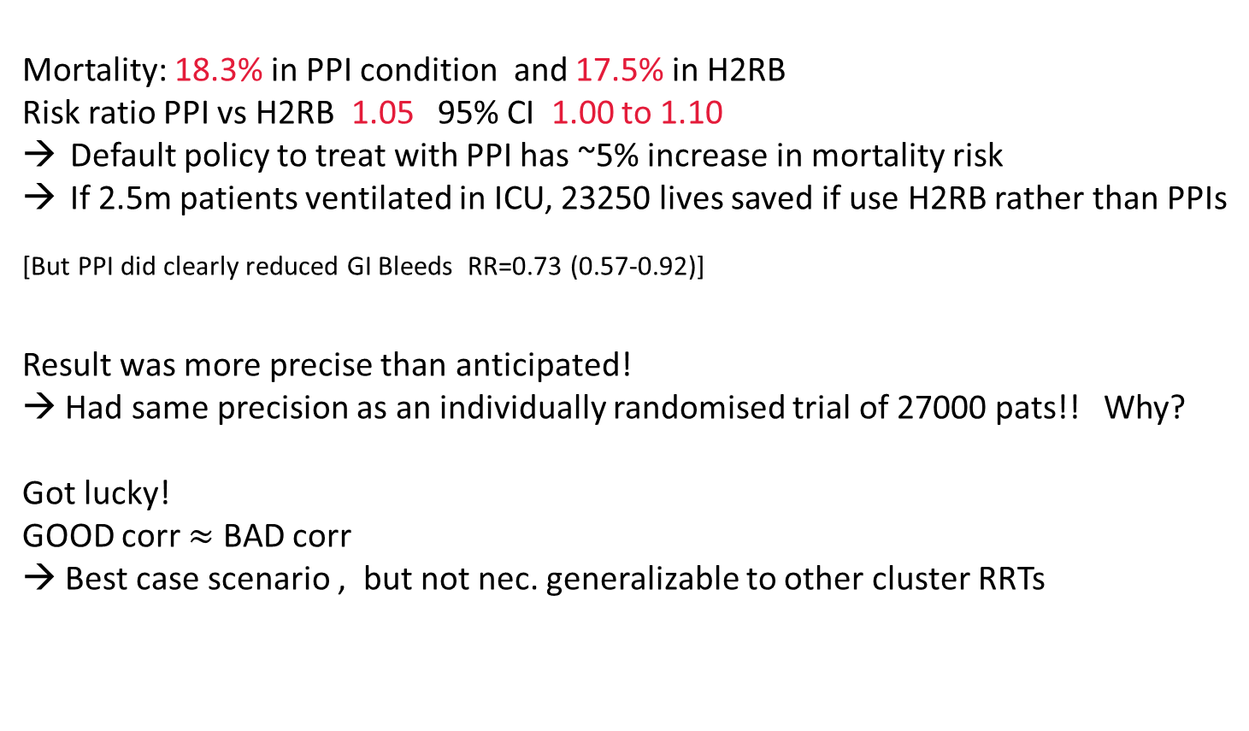
Results : (1) Cluster RRTs are great
Mortality: 18.3% in PPI condition and 17.5% in H2RB
Risk ratio PPI vs H2RB 1.05 95% CI 1.00 to 1.10
Default policy to treat with PPI has ~5% increase in mortality risk
If 2.5m patients ventilated in ICU, 23250 lives saved if use H2RB rather than PPIs
[But PPI did clearly reduced GI Bleeds RR=0.73 (0.57-0.92)]
Result was more precise than anticipated!
→ Had same precision as an individually randomised trial of 27000 pats!! Why?
Got lucky!
GOOD corr $≈$ BAD corr
→ Best case scenario , but not nec. generalizable to other cluster RRTs

Slide 18
Results: (2) Cluster RRTs are not so great
Adherence differed between conditions – from audit snapshots
PPI periods: ~82% of patients received PPI, and 4.1% H2RB
H2RB periods: ~64% received H2RB, and 20% PPI
→ Muddied interpretation of trial
Actual treatments used for individuals NOT captured in registry so couldn’t do individual-patient “compliance-adjusted” analysis

Slide 19
Overall PEPTIC registry trial comments
The embedding in a registry was the greatest asset for PEPTIC but also ended up being the greatest limitation
  Correspondence with JAMA reviewers and readers focussed almost completely on the compliance difference
BUT OVERALL:
Site recruitment, consent/participation, primary outcome data collection via registries functioned superbly
Remarkable (but lucky) precision
PEPTIC is (still) the largest ICU trial ever conducted

Slide 20
General cluster crossover comments
Not all individually randomised trials are suitable for conduct as cluster crossover:
Treatments must be able to be implemented and withdrawn easily
Need to avoid carry over of effects from 1st to 2nd period
  at site level (especially if open label)
  at individual level (if exposure is prolonged)
  Washout periods or other strategies can assist
Requires all-comers: Individual patient recruitment after randomisation can lead to ‘selection bias’
Best if can blind treatments (unable in PEPTIC)

Slide 21
General cluster crossover RRT conclusions
Requirements for cluster crossover trials are very well suited for conduct within a registry
  Esp comparative effectiveness trials of routinely used interventions, taking all comers, with waiver or opt-out consent
Crossover reduces the number of clusters and patients needed, often +++
  Can cross over multiple times for greater reductions (eg ABAB/BABA)
  Potential for factorial trials, adaptive trials etc
However, are more prone to bias than individual-patient RCTs
  Needs care in design
  May need registry-based data collection to be supplemented to address those biases (e.g. compliance as in PEPTIC)

Slide 22
THANK YOU

Slide 23
Slide title

Slide 24
Adherence
From compliance audits:
Among PPI-group patients, an estimated 82.5% received PPI, 4.1% received H₂RB, 1.9% received both PPI and H₂RB, and 11.5% received neither.
Among H₂RB-group patients, an estimated 20.1% received PPI, 63.6% received H₂RB, 5.1% received both PPI and H₂RB, and 11.2% received neither.

