Slide 1
’Implementability’:
How to plan, design, conduct and report clinical trials optimised for value to end-users
Steve Webb: Board Sponsor, ACTA Impact and Implementation Reference Group
Super Webinar, Feb 11, 2020
ACTA gratefully acknowledges operational funding from the Australian Government’s Medical Research Future Fund
www.clinicaltrialsalliance.org.au
Notes:
Paraphased as making trials that are as useful as possible to clinicians, policymakers, and consumers who are the users of evidence generated by trials.

Slide 2
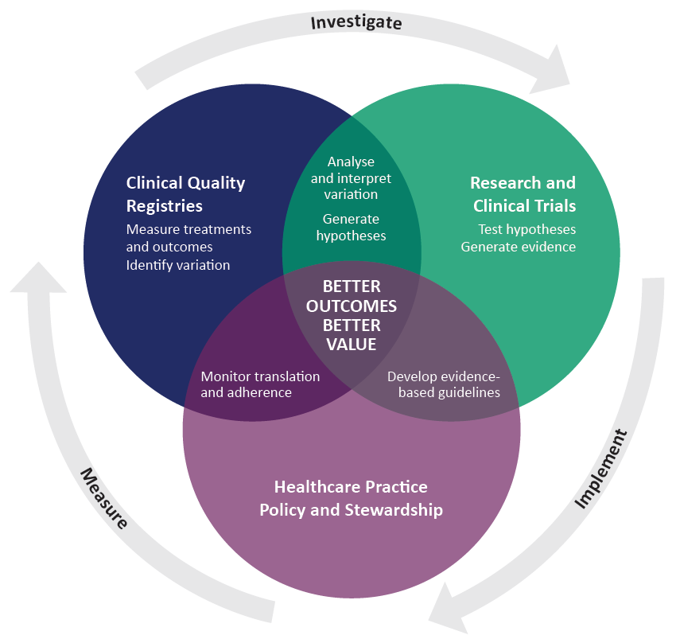
A Learning Healthcare System
Fundamental principles
High quality healthcare is critical to patients and saves money
High quality care (value-based healthcare) is evidence-based
Best evidence is derived from randomised clinical trials (RCTs)
Notes:
The delivery of high-quality health care relies on the availability of high-quality evidence to inform best practice. An emerging concept is the Learning Healthcare System, which provides a cost-effective system embedded within healthcare delivery to identify priority research questions, undertake high-quality research, understand the knowledge gained from clinical research, to implement findings where appropriate, and to measure the resulting change in health practice

Slide 3
A Learning Healthcare System
The role of RCTs is to test interventions to prove/disprove a hypothesis
Notes:
In this Learning Healthcare System, the role of randomised controlled trials is to test interventions to prove/disprove a hypothesis

Slide 4
A Learning Healthcare System
RCTs are critical to transitioning from opinion-based care to evidence-based care
Notes:
In this Learning Healthcare System, the role of randomised controlled trials is to test interventions to prove/disprove a hypothesis

Slide 5
A Learning Healthcare System
RCTs are necessary but not sufficient.
Notes:
In this Learning Healthcare System, the role of randomised controlled trials is to test interventions to prove/disprove a hypothesis

Slide 6
A Learning Healthcare System
Evidence generated by trials needs to be implemented into practice and policy to have impact
Notes:
In this Learning Healthcare System, the role of randomised controlled trials is to test interventions to prove/disprove a hypothesis

Slide 7
ACTA Impact and Implementation Reference Group
ACTA gratefully acknowledges operational funding from the Australian Government’s Medical Research Future Fund
www.clinicaltrialsalliance.org.au

Slide 8
Reference Group Members
Sally Green
Chris Levi
Sophia Zoungas
Alan Cass
Judith Trotman
Frank Bloomfield
Phillipa Middleton
Anne Wollett
Karen Best
Dash Gartner
Paul Glasziou
Davina Ghersi
Greg Sharplin
Carolina Weller
Helena Teede
Paul Scuffham
David Johnson
Angela Scheppokat
Paul Cohen
Tim Shaw
Sandra Peake
Stephen Jan
Sam Keogh
Sue Crengle
Val Theisz
Tiffany Harris-Brown
Heidi Gaulke
Karin du Plessis
David Story
Ann Wilson
ACTA gratefully acknowledges operational funding from the Australian Government’s Medical Research Future Fund
www.clinicaltrialsalliance.org.au
Notes:
Work of large number of people, list in this slide. Particularly want to thank the Chairs of this reference group, Sally Green and Chris Levi, as well as Sophia Zoungus who was a co-chair until earlier this year.
Present the high-level principles that have evolved from the work of this group. Not yet had opportunity to review the most recent round of feedback so some elements may change, but I think the high-level principles are sound.

Slide 9
ACTA Guideline:
Guidance on Implementability
ACTA gratefully acknowledges operational funding from the Australian Government’s Medical Research Future Fund
www.clinicaltrialsalliance.org.au

Slide 10
EVIDENCE is information to guide decision making
Notes:
Research is Pragmatic activity

Slide 11
The ultimate purpose of clinical trials is to generate EVIDENCE to inform and change clinical practice
Notes:
Research is Pragmatic activity

Slide 12
Clinical Trial Phases
Early phase clinical trial: A clinical trial that aims to learn about the potential value of a candidate intervention, to determine whether further trials are warranted.
Early phase trials are typically not designed to provide definitive evidence of the value of the intervention. Such trials typically evaluate surrogate clinical or biological outcomes, and are often underpowered to detect differences in clinically meaningful outcomes or endpoints.
Implementation into practice and policy is generally not appropriate for early phase clinical trials.
Notes:
Unfortunate amount of confusion regarding the nomenclature associated with phases of clinical trials.
Reference Group uses the term to early phase trial to apply to trials that determine if future trials are warranted.
Correspond to phase I and II clinical trials.
‘Unsure’ is a combination of self-reporting as informal entity or unincorporated association. We personally think most of these are in a relationship with a parent organization. Unincorporated association is a bit more stand alone than a sub-entity of a parent organization e.g own logo.
COGNO is reported as unincorporated association but we think Uni Sydney probably takes the liability/clinical trial Sponsor as uni Sydney ABN listed on website.

Slide 13
Clinical Trial Phases
Late phase clinical trial: A clinical trial intended to estimate the effectiveness of a candidate intervention in comparison to alternative interventions or standard practice, and in large enough groups of people to provide precise and applicable estimates of the effects (both positive and negative) on health outcomes.
Late phase trials are intended to provide information to end-users to inform decisions about whether the candidate intervention should be adopted into practice or policy, should the results prove definitive.
For interventions that are a drug or device, late phase trials may occur before or after the new drug or device is registered.
Notes:
Corresponds to phase III and phase IV RCTs
End-users of late phase trials are clinicians, policy-makers, and consumers who make decisions about practice, policy, and stewardship.

Slide 14
Implementation
Implementation: The sustainable introduction to, or removal of, an intervention from clinical practice or policy.
Implementation may, or may not, be appropriate following the completion of a clinical trial.
Uptake into evidence synthesis is also an important step towards implementation into practice or policy.

Slide 15
Appropriate Implementation
Appropriate implementation: A decision about whether it is appropriate to implement a candidate intervention should be informed by a body of evidence of sufficient certainty, often a systematic review.
This decision should consider the balance of likely benefits and harms, applicability of the evidence to the relevant context, acceptability of the intervention, resources available, feasibility of implementation, and other considerations such as equity.

Slide 16
Implementability
Implementability: Characteristics of the design, execution and reporting of a clinical trial, typically a late phase trial, that determine the capacity for the evidence generated by that clinical trial to be used for implementation.
Implementability is a feature of trial design and execution that is not contingent on the results of a trial, whereas appropriate implementation is critically dependent on both the results and implementability.
Notes:
All trials are not equal with respect to the capacity of the results of the trial to change practice, policy and stewardship
End-users of late phase trials are clinicians, policy-makers, and consumers who make decisions about practice, policy, and stewardship.

Slide 17
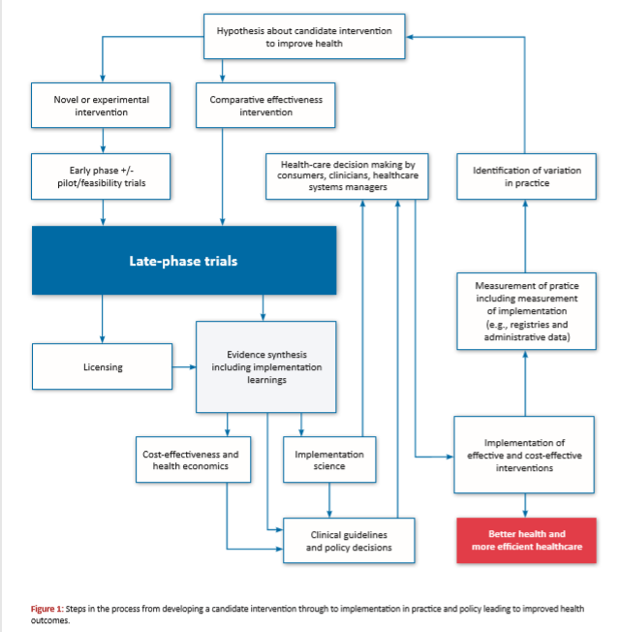

Slide 18
End-users
End-users of evidence
RCT
RCT
RCT
RCT
RCT
RCT
RCT
Notes:
For late phase clinical trials, the requirements of the end-users are critical.

Slide 19
End-users
Consumers Clinicians Policymakers
RCT
RCT
RCT
RCT
RCT
RCT
RCT
Notes:
For late phase clinical trials, the requirements of the end-users are critical.

Slide 20
ACTA Guidance on Implementability
Objective is to provide guidance on the planning, design and conduct, and reporting of clinical trials so that the results of trials are optimised for implementability, (i.e., to optimise the characteristics of a clinical trial that determine the capacity for the evidence generated by that clinical trial to be implemented into practice and policy).
Intended to apply to late-phase clinical trials.
A guidance document, with selected examples, and a check list.
Make trials that are useful to consumers, clinicians, and policymakers
Notes:
Intention is to be used by the teams who design and conduct clinical trials to make the trial as useful as possible to clinicians, consumers, and policymakers who are the users of evidence generated by trials.
‘Unsure’ is a combination of self-reporting as informal entity or unincorporated association. We personally think most of these are in a relationship with a parent organization. Unincorporated association is a bit more stand alone than a sub-entity of a parent organization e.g own logo.
COGNO is reported as unincorporated association but we think Uni Sydney probably takes the liability/clinical trial Sponsor as uni Sydney ABN listed on website.

Slide 21
Implementability, Pragmatic Designs, Embedded Designs
Implementability
Embedded
Pragmatic

Slide 22
Optimising Implementability
Planning Phase
Design and Conduct Phase
Reporting Phase
ACTA gratefully acknowledges operational funding from the Australian Government’s Medical Research Future Fund
www.clinicaltrialsalliance.org.au

Slide 23
Optimising Implementability
Planning Phase
consultation or co-design with end-users
a well-developed understanding of current practice
any necessary pre-trial establishment of feasibility of delivery of the intervention
consideration of the appropriate trial design
consideration of whether regulatory approval is a likely component of implementability
consideration of conducting the trial within a network
access to the skills necessary to consider issues of implementability, and
consideration of including within the trial protocol a section that identifies and discusses issues related to the implementation of the results of the trial, contingent on the different results that might emerge from the trial.

Slide 24
Consultation or co-design with end-users
Define the end-users
Which end-users are critical to implementation?
Different end-users have different preferences, perspectives, and values
Understand the evidence needs and requirements of end-users
Relevance of question to practice and policy
Choice of comparator
Methods for delivery of intervention
Choice of end-points
Notes:
many components of trial activity that can contribute to implementabilty can be enhanced by involving end-users during the trial planning stage
It should be noted that involvement of end-users can improve other aspects of trial design and conduct, contributing to trial efficiency and effectiveness, but are out-of-scope in this document.
explicitly identify all intended groups of end-users and consider the relative importance of each end-user group from the perspective of implementation of the results of the trial

Slide 25
Consultation or co-design with end-users
Minimum clinically significant difference
Particularly where a conclusion of ‘no difference’ is intended to influence practice or policy / non-inferiority designs
Trial entry criteria can be applied by end-users
Ensure easy identification of the target population in practice

Slide 26
Context- what is current baseline practice or policy
Implementation always occurs in the context of current practice
Is trial intervention part of current standard care? If so, in what proportion of patients?
What are the alternatives? Is the proposed comparator valid?
A de-implementation trial of a widely implemented, but unproven, intervention should generally only occur if there is suspected harm or known burden
Surveys, focus groups, observational studies

Slide 27
Can complex interventions be delivered in a trial?
Pilot studies of feasibility
If a complex intervention can’t be delivered in a trial, probably can’t be delivered in practice
ACTA gratefully acknowledges operational funding from the Australian Government’s Medical Research Future Fund
www.clinicaltrialsalliance.org.au

Slide 28
Regulatory approval and implementability
In some interventions, regulatory approval may be necessary for implementation
Therapeutic Goods Administration (TGA)
Benefits may include:
Improved access to therapeutic options
Facilitating access to subsidisation
Safety monitoring for treatment-related adverse events
Notes:
Features that should be considered at the design phase pre-empt the information necessary to be submitted in support of registration. This includes a clear rationale for the study, particularly with respect to clinical (unmet) need, justification of the population selected for the trial and the dosage chosen for the trial, detailed plan and explanation of the rationale for the selected statistical approach, justification of the efficacy and clinical relevance of the selected efficacy end-points, sufficient information to describe and understand safety-related events, and an overview of how the results of the trial, related to trial quality, efficacy, and safety, all support the regulatory submission.
Guidance on Implementability Page 14 of 34
The specific requirements will depend on the nature of the application and details are available at https://www.tga.gov.au/ collection/argpm and disease and therapeutic area-specific TGA adopted guidelines are also available at https://www.tga. gov.au/ws-sg-index

Slide 29
Composition of trial team
Consumer membership
Clinician and policymaker membership
Health economics
Implementation science
Notes:
The impact of the composition of the trial team on implementability should be considered during the planning stage. As outlined with respect to end-users, involvement of consumers, clinicians, and policy-makers, as appropriate, as members of the trial team is likely to enhance implementability. Particularly for complex interventions (Delaney, et al., 2008; Craig, et al., 2008), consideration should be given to involvement of clinicians who will be involved in delivery of the intervention. Where health economic considerations are likely to be relevant to implementation, involvement of a health economist should be regarded as mandatory as elements of an appropriate health economic analysis may not be possible unless incorporated into planning and designing the trial. Where implementation, or particularly de-implementation, is likely to be challenging, strong consideration should be given to including implementation scientists in the trial team so that insights regarding implementation challenges and opportunities can be incorporated within the planning and design of the trial.

Slide 30
Involvement of a clinical trial network (CTN)
Many clinical trials are undertaken by a network
Members often have dual roles as clinician and researcher
Many CTNs have consumers as members
The benefits of conducting a trial within a CTN are believed to contribute to appropriate implementation of the results of the trial
Notes:
Many, but far from all, clinical trials are undertaken by a network. The majority of the members of most networks are individuals who have dual roles as researchers and clinicians. Many networks also have consumers as members. An important feature that contributes to the impact of trials conducted by networks, is that these end-users contribute, via formal or informal processes, to the planning, conduct and reporting of trials. The involvement of these end-users within the network is also believed to contribute to appropriate implementation of the results of trials conducted by the network. Other aspects of conducting a trial within a network that can contribute include access to accumulated experience with all aspects of planning, design, conduct and reporting that facilitate implementability. Networks can also provide access to trial sites that are representative of the clinical sites and population in which the results would be applied. Lastly, some networks, either by themselves or in conjunction with an associated registry, are well positioned to monitor actual implementation.

Slide 31
Consideration of implementation in trial protocol
Designation as a late phase trial, intended to have capacity to influence practice or policy
Explicit identification of the end-users, results from consultation or co-design
Intended population to which results are applicable (and burden of disease)
Pre-specification of how different results should influence implementation
Enablers and barriers to implementation (or de-implementation)
Plans for contribution to evidence synthesis and measurement of implementation

Slide 32
Optimising Implementability
Design and Conduct Phase
Population to which trial results apply
Characteristics of implementability of the intervention being tested
Choice of comparator
Concomitant care
Outcome measures
Population context information
Process evaluation and fidelity
Health economics

Slide 33
Population to which trial results apply
Trial site characteristics and generalisability
Relationship of trial entry criteria and target population
Narrow populations may enhance likelihood of ‘positive trial’ but limit implementability
If suspected differential treatment effect, consider stratification
Screening and recruitment
Pragmatic and / or embedded enhances implementability

Slide 34
Delivery of trial intervention
Want to know if intervention works under ‘real-world’ conditions
Interventions should be delivered in the same way in trial as intended to occur in practice
Train clinical staff, avoid research staff delivering the intervention
Processes to enhance adherence or compliance should be those that occur in practice
Adjustment or titration of intervention should be those that are feasible in practice

Slide 35
Choice of comparator
Comparator should be clinically meaningful
What if there is marked variation within current standard care
Choose most common variant as compactor
Allow clinician to do what they would normally do
Blinding and placebo
Can be critical for implementation (especially de-implementation)
But not always necessary and placebo is not a treatment option in actual practice

Slide 36
Health Economics
Often critical to decision-making regarding implementability
Requires planning and incorporation of appropriate data collection at design phase
Needs a health economist

Slide 37
Further design and conduct features
Population context information
Where possible, a trial should report information on eligible but non-randomised patients, i.e. nesting within registry
Process and fidelity evaluation
For complex interventions, process evaluation using mixed methods to understand factors associated with fidelity of delivery

Slide 38
Optimising Implementability
Trial Reporting Phase
Commitment to complete and timely reporting
Sufficient information to guide delivery of the intervention
Data sharing
Accessibility of trial results
Declaration of interests

Slide 39
Commitment to timely and compete reporting
A trial that is not reported has no capacity to influence implementation
Particularly important for trials that failed to recruit or deliver an intervention
Report as per CONSORT or its variants
Published SAP prior to database lock

Slide 40
Sufficient information to deliver intervention in practice
Particularly for complex intervention, if intervention not described can’t be implemented
TIDIER checklist
Availability of study tools and training material

Slide 41
Other aspects of reporting
Data sharing
Respond to requests to assist evidence synthesis
IPDMA
Accessibility of results to end-users
Declaration of interests

Slide 42
Clinical problem
Clinical trials generates evidence on optimal treatment
Evidence Synthesis
Implementation into practice and policy
Implementability
ACTA gratefully acknowledges operational funding from the Australian Government’s Medical Research Future Fund
www.clinicaltrialsalliance.org.au

Slide 43
Impact
Impact: The change in health outcomes or health system productivity or both that arises from the implementation of evidence, including clinical trials.
Impact maximised by optimising implementability
“in order to be useful, clinical research should be true, but this is not sufficient”
Michael Ioannidis

Slide 44
Find out about resources, events and membership on www.clinicaltrialsalliance.org.au

Slide 45
Coming event

Slide 46
Our next webinar

